Slide 1

Pimpri Chinchwad Education Trust’s Pimpri Chinchwad College of Engineering Department of Computer Engineering
JEEVIKA
(Smart Hospital Connectivity)
-Ashley George (TECOA133)(Leader)
-Rohan Hirwe(TECOA138)
-Prajakta joshi(TECOA146)
-Bhagyashree Kadam(TECOA148)

Slide 2
Index
Aim
Scope
Stakeholders
SRS
Requirements
Process Model
Use Cases
Feasibility

Slide 3
Aim
Hospitals face problems during emergencies such as:
Urgent availability of BLOOD and ORGANS
Shortage of MEDICINES
Unavailability of AMBULANCE
For this the hospitals have to contact each and every known hospital in its
vicinity which is very time consuming and maybe sometimes unreliable too
thus risking life of the patient.
Here we aim at providing technological solution to above problem by
building a robust communication channel between hospitals.
The only motto is to improvise the search during emergencies, making it
efficient, thus minimizing the dangers due to unavailability of necessities.

Slide 4
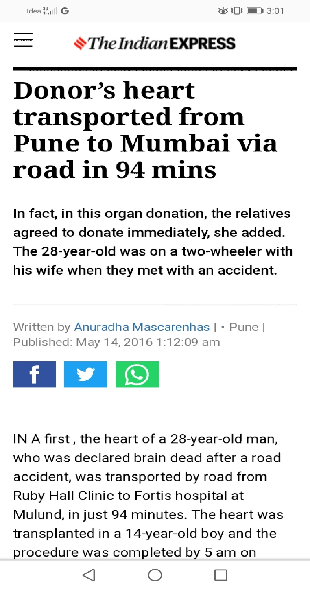
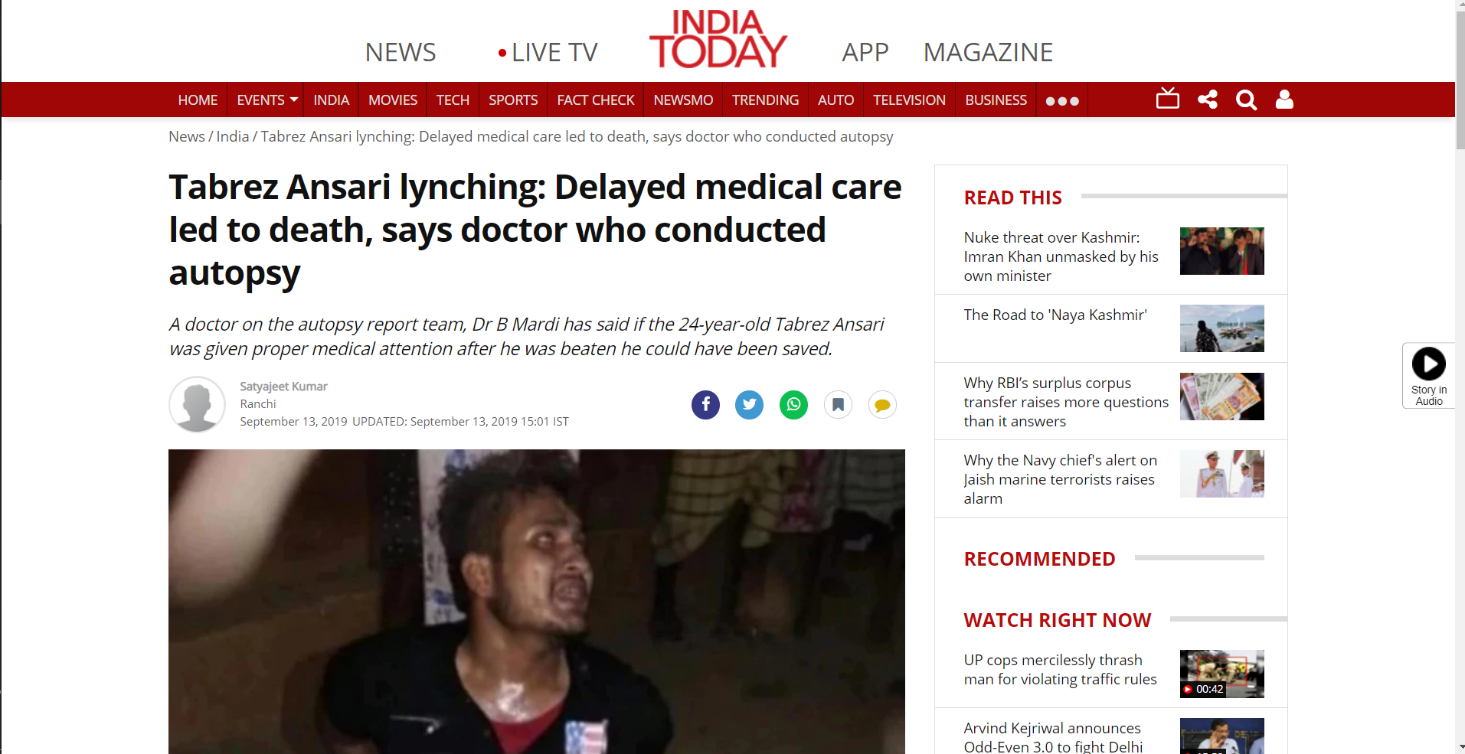
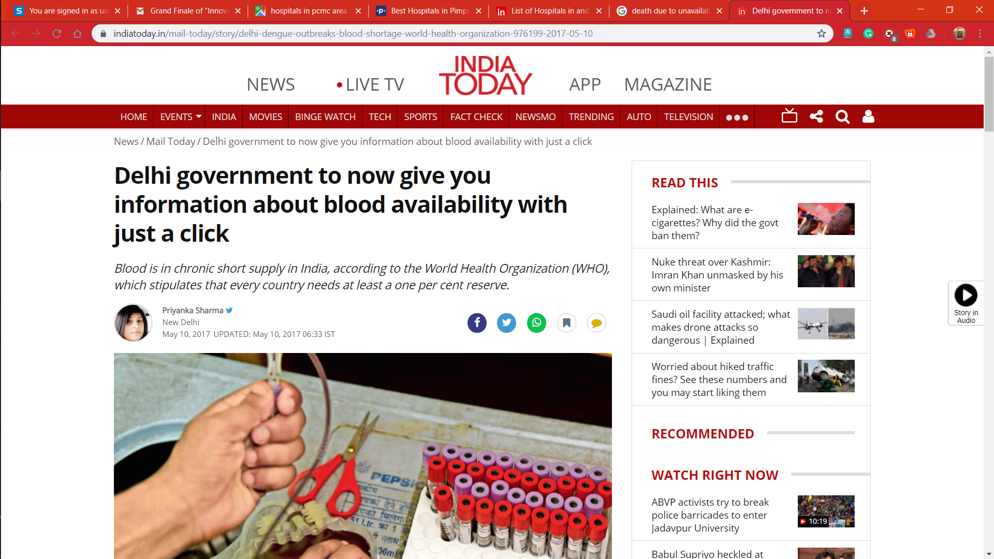
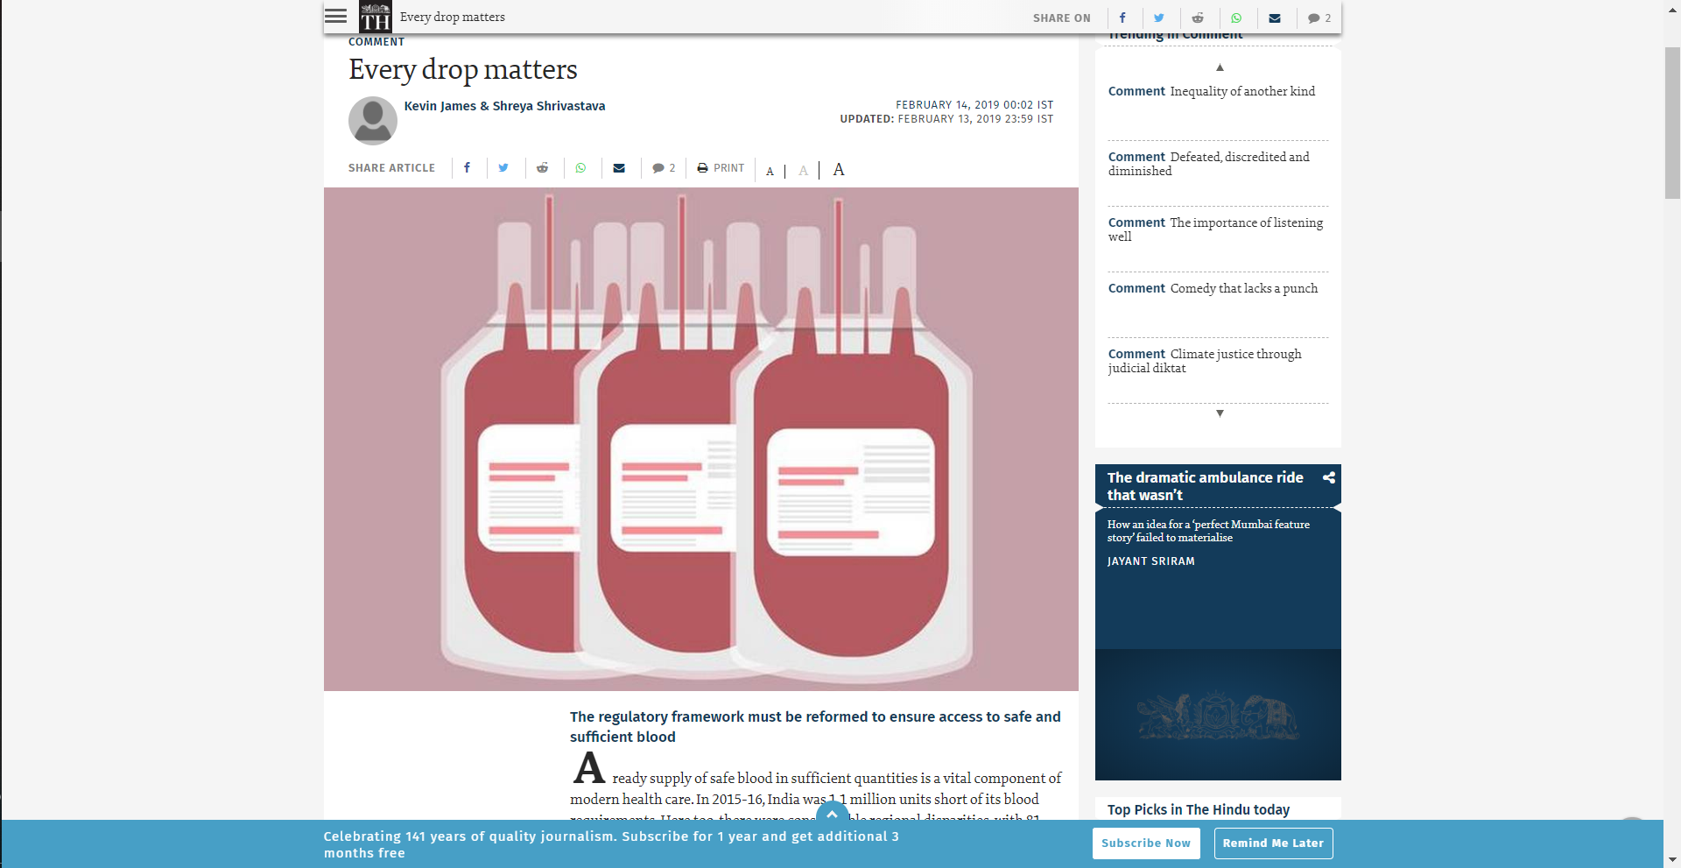
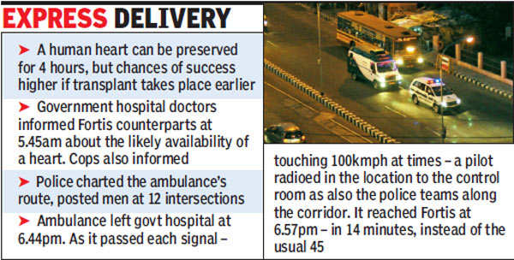

Slide 5
Scope
The scope of this project is an online shopping system which allows:
1) Users to search necessities during emergencies ,update stocks of the necessities, make and receive payment ,and give feedback.
Admin can verify / validate and block users.
NOT IN SCOPE:
- Delivery of the necessity(concern of participating users).

Slide 6
Stakeholders
User(Hospital)
Maintenance Team
Blood Bank
Organ Bank
Pharmacy

Slide 7
Software Requirement Specification
Purpose
The purpose of this SRS is to specify the requirements of the web based software application-named “JEEVIKA”. This Software Requirements Specification provides a complete description of all the functions and specifications of modules. This document contains the software requirements of Jeevika.

Slide 8
Description
As a solution to the problem ,we aim at creating a web application named “JEEVIKA” for the hospitals in our area.
This application will show real time availability of blood ,medicines, organs and ambulances with hospitals.
This communication channel will help hospitals to communicate with the nearby hospitals and send a request for supply.
This application will generate best options to serve the emergency situation on the basis of Shortest distance to the hospital which can supply the necessaries .
This platform will help in distributing load with other hospitals, thus increasing the emergency handling capacity.
Data provided by the hospitals will not be visible to other hospitals.
All the computation regarding best available options will be done by our application without compromising the privacy of hospitals.

Slide 9
Functional Requirements
This section provides requirement overview of the system. Various functional modules that can be implemented by the system will be –
1.Hardware Requirements :
This system will work on client-server architecture. It will require an internet server and which will be able to run the application. The system should support some commonly used browser such as IE, Chrome etc.

Slide 10
Software Requirements
Registration :If user wants to search for the necessity then respected user must be registered, unregistered user can’t go to the shopping cart.
Login : User logins to the system by entering valid user id and password for JEEVIKA.
Changes to Cart : Changes to cart means the user after login or registration can make order or cancel order of the necessity from the cart.
Payment :For customer there are many type of secure billing will be prepaid as debit or credit card, post paid as after shipping, check or bank draft. The security will provide by the third party like Pay-Pal etc.
Logout After the payment or surf of the necessity the customer will logged out.
Report Generation After all transaction the system can generate the portable document file (.pdf) and then sent one copy to the user’s Email-address and another one for the system data base to calculate the monthly transaction .
Database management: Database will be internally connected with the already existing database of the hospitals/banks so that whenever there will be any changes in the database , it will automatically be reflected in our database.

Slide 11
Non-functional requirements
Availability : The system should be available at all times, meaning the user can access it using a web browser, only restricted by the down time of the server on which the system runs. In case of a of a hardware failure or database corruption, a replacement page will be shown. Also in case of a hardware failure or database corruption, backups of the database should be retrieved from the server and saved by the administrator. Then the service will be restarted. It means 24 X 7availability.
Reliability The system provides storage of all databases on redundant computers with automatic switch over. The reliability of the overall program depends on the reliability of the separate components. The main pillar of reliability of the system is the backup of the database which is continuously maintained and updated to reflect the most recent changes. Thus the overall stability of the system depends on the stability of container and its underlying operating system.

Slide 12
Non-functional requirements
Scalability : The system is scalable. New features (modules) can be added whenever required.
Security: The system will use SSL (secured socket layer) in all transactions that include any confidential customer information. The system must automatically log out all customers after a period of inactivity. The system should not leave any cookies on the customer’s computer containing the user’s password. The system’s back-end servers shall only be accessible to authenticated administrators. Sensitive data will be encrypted before being sent over insecure connections like the internet.
Maintainability A commercial database is used for maintaining the database and the application server take care of the site. In case of a failure, a re-initialization of the program will be done. Also the software design is being done with modularity in mind so that maintainability can be done efficiently
Performance There is no performance requirement in this system because the server request and response is depended on the end user internet connection

Slide 13
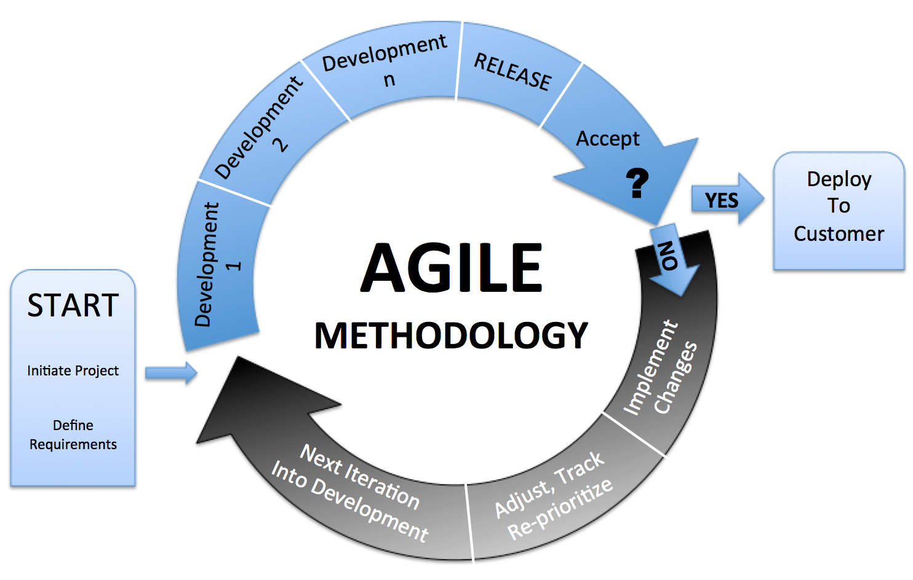
Process Model: Agile

Slide 14
What is Agile ?
Agile software engineering combines of philosophy and a set of development guidelines. The philosophy encourages customer satisfaction and early incremental delivery of software; small, highly motivated project teams; informal methods; minimal software engineering work products; and overall development simplicity. The development guidelines stress delivery over analysis and design (although these activities are not discouraged), and active and continuous communication between developers and customers.
Software engineers and other project stakeholders (User, admin,blood bank,organ bank,pharmacy) work together on an agile team—a team that is self-organizing and in control of its own destiny.

Slide 15
Our reason for Agile Methodology
User satisfaction by rapid, continuous delivery of useful software.
Working software is delivered frequently (weeks rather than months).
The model will be developed step-by-step. First Blood then Organs, then Ambulance and so
on.
Continuous attention to technical excellence and good design.
Regular adaptation to changing circumstances.

Slide 16
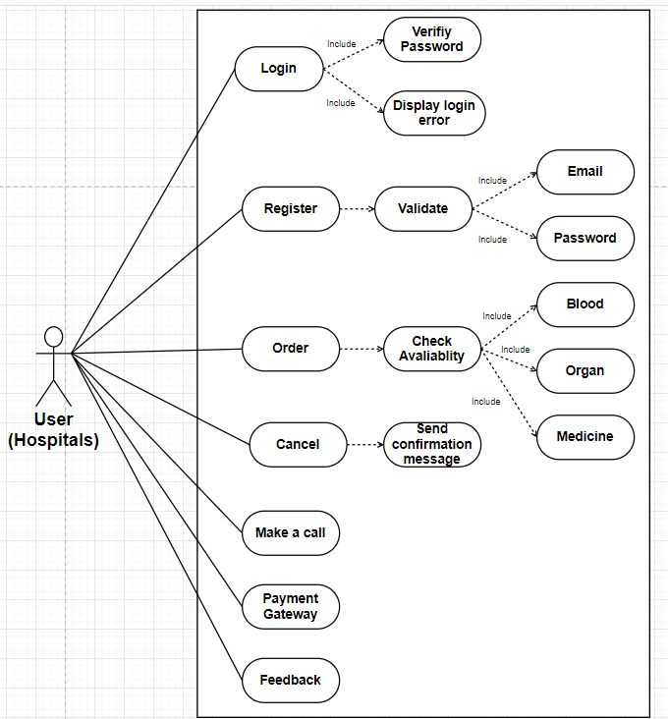
Use cases:

Slide 17
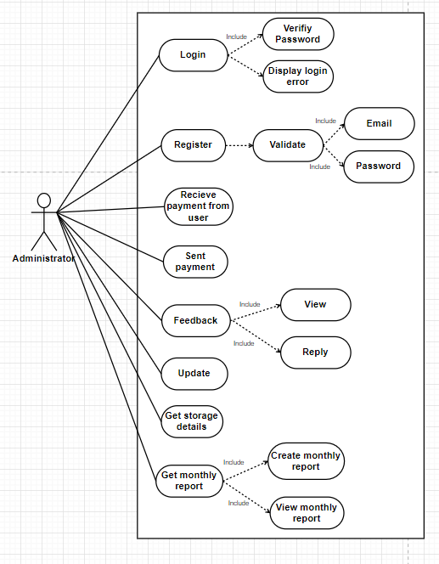

Slide 18
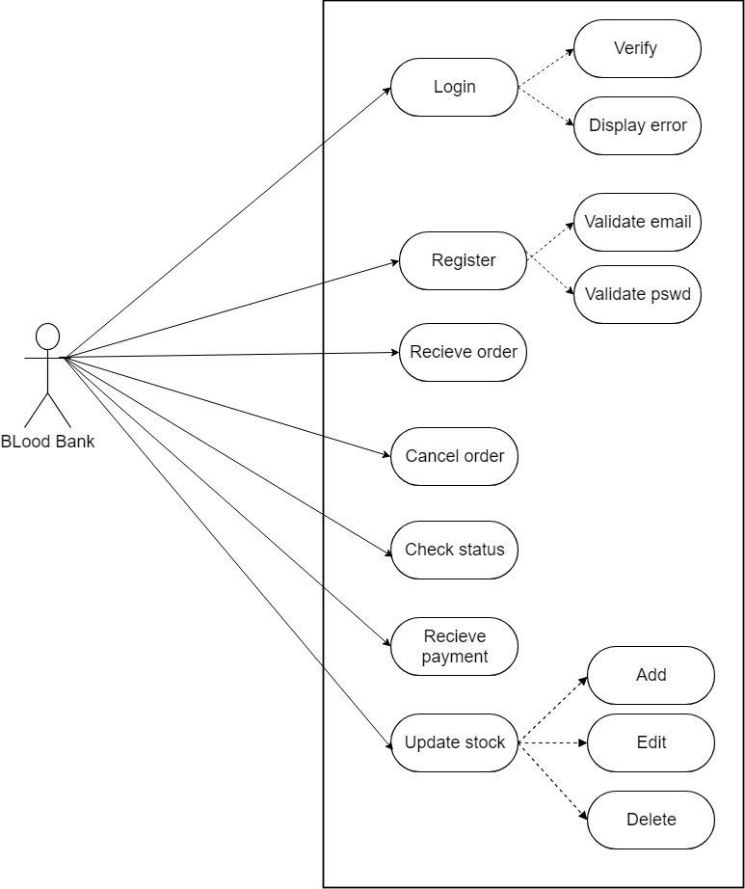

Slide 19
Name : Login
Scope: Used by user to login into his/her account.
Actor: User, Admin, blood bank, organ bank, pharmacy.
Pre-conditions: 1.Internet access
2.Knowing his/her credentials.
3.Registration should be completed.
Main-scenario:
1. User opens the website
2. User clicks on login button
3. User enters his email and password
4. Details are sent to a server and verified
5. If credentials are correct then user is allowed to proceed and is redirected to view availability status
page to know the available amount of stock.
6. Else Appropriate msg is displayed if the authentication fails and user is asked to re-enter his details
7. If user enters incorrect details for 3 times continuously then a forgot password mail is sent to the
user and no further action is permitted unless user resets the password by clicking a link on his mail
Post-conditions: User is Logged in.

Slide 20
Name: Register.
Scope: For user to register.
Actor: User, Admin,blood bank,organ bank,pharmacy. .
Pre-conditions: None
Main-scenario:
1. User opens the website
2. User clicks on register button
3. User enters his email and password
4. Appropriate msg is displayed if email already exists , password not strong ,etc
5. User enters his other required details.
6. Registration is complete and user is redirected to login page
Post-conditions: User is Registered

Slide 21
Name: Order
Scope: User can order his requirements
Actor: User. .
Pre-conditions: User needs to have an account.
Main-scenario:
1. User opens the website
2. User logs in to his account if registered, else needs to create an account by registering to provided link on the site.
3. After login user needs to click on his required product like blood or organ or medicine.
4. Once user selects his requirements he can check the availability status of the product.
5. If sufficient amount is present the user can make a order ,else “Insufficient product” message is displayed.
6. User needs to make payment after his completion of order.
7. User can make a call if required.
8. User can logout.
Post-conditions: Ordered required amount of product successfully

Slide 22
Name: Cancel
Scope: User can cancel his order
Actor: User. .
Pre-conditions: 1. Order of a product is required
2. Can cancel an order only within 30min after order placed.
Main-scenario:
1. User opens the website
2. User logs in to his account .
3. Once logged in, user can cancel his order by clicking on cancel order button.
4. User can request admin to return his desired amount .
5. User can make a call if required.
6. User can logout.
Post-conditions: Order successfully canceled.

Slide 23
Name: Payment
Scope: User can make his payment
Actor: User.
Pre-conditions: Order of a product is required.
Main-scenario:
1. Once order is completed ,user can make payment by clicking on make payment option .
2. He can choose the mode of payment.
3. User will proceed to payment gateway.
4. User can logout.
Post-conditions: .Payment done successfully.

Slide 24
Name: Feedback
Scope: User can submit a feedback
Actor: User
Pre-conditions:
User is logged in
Main-scenario:
1. User may give feedback on a particular product from any page where product is visible
2. User can write a title and message body
3. The feedback will be sent to admin on clicking submit button
Post-conditions: User has given a feeedback

Slide 25
Name: Reply to Feedback
Scope: Admin can view and reply to the feedback received
Actor: Admin
Pre-conditions: Admin needs to login
Main-scenario:
1. Admin has to firstly login to his account.
2. To view feedback he has to click view option.
3. Admin can also reply to feedback if needed and solve any query by the user
Post-conditions: Feedback viewed and replied if necessary

Slide 26
Name: Receive payment
Scope: Payment is received by Admin
Actor: Admin
Pre-conditions: Admin needs to login
Main-scenario:
1. Admin has to firstly login to his account.
2. Admin receives amount transferred by user .
3. Admin cross checks the amount individually sent by the user, and sends message if sent amount is not correct.
4. If payment not received by any user “Payment pending” message is sent to the user .
5. If more than 3 payments by an individual user is pending then the admin can block that user’s account.
Post-conditions: Payment received confirmation and appropriate action taken if payment not done

Slide 27
Name: Update
Scope: Blood bank ,organ bank and pharmacy can add ,edit and delete their data
Actor: Blood bank ,organ bank and pharmacy
Pre-conditions: Blood bank ,organ bank and pharmacy need to login
Main-scenario:
1. Blood bank ,organ bank, pharmacy need to login to their account
2. They are available with 3 options as edit, delete or add and can choose and do appropriate actions
3. Blood bank ,organ bank, pharmacy can delete any product name if it is not available with them and can add that product name again once made available.
4. Whenever an order is placed ,they have to update the product availability accordingly.
Post-conditions: The data gets updated

Slide 28
Name: View Monthly reports
Scope: Blood bank ,organ bank and pharmacy can view monthly reports and analyze accordingly
Actor: Blood bank ,organ bank and pharmacy
Pre-conditions: Blood bank ,organ bank and pharmacy need to login
Admin has to create monthly report
Main-scenario:
1. Blood bank ,organ bank, pharmacy need to login to their account
2. They can view monthly reports by clicking the view button available
3. Blood bank ,organ bank, pharmacy can analyze the data according to monthly report generated
Post-conditions: Generated Monthly reports are viewed and analyzed

Slide 29
Name: Create Monthly reports
Scope: Admin creates the monthly report
Actor: Admin
Pre-conditions: Admin needs to login
Blood bank ,organ bank, pharmacy needs to update their repective data before generating monthly report
Main-scenario:
1. Admin has to login to his account
2. He has to check the availability status, orders received daily to generate the report
3. Once generated it can be viewed by Blood bank ,organ bank, pharmacy
Post-conditions: Monthly report generated

Slide 30
Classes
Admin
User
Bank
Necessity
Payment
Order
Cart
Feedback

Slide 31
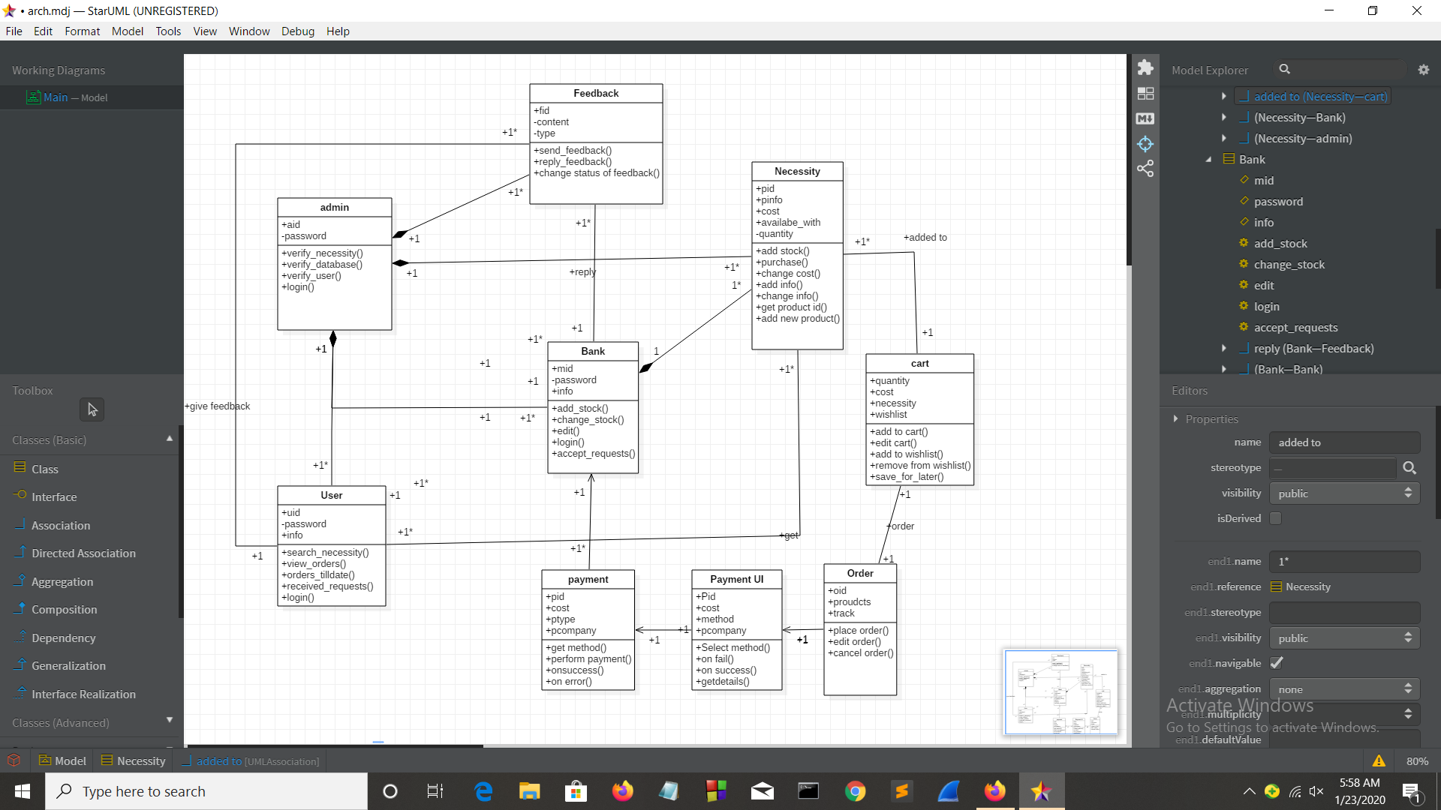

Slide 32
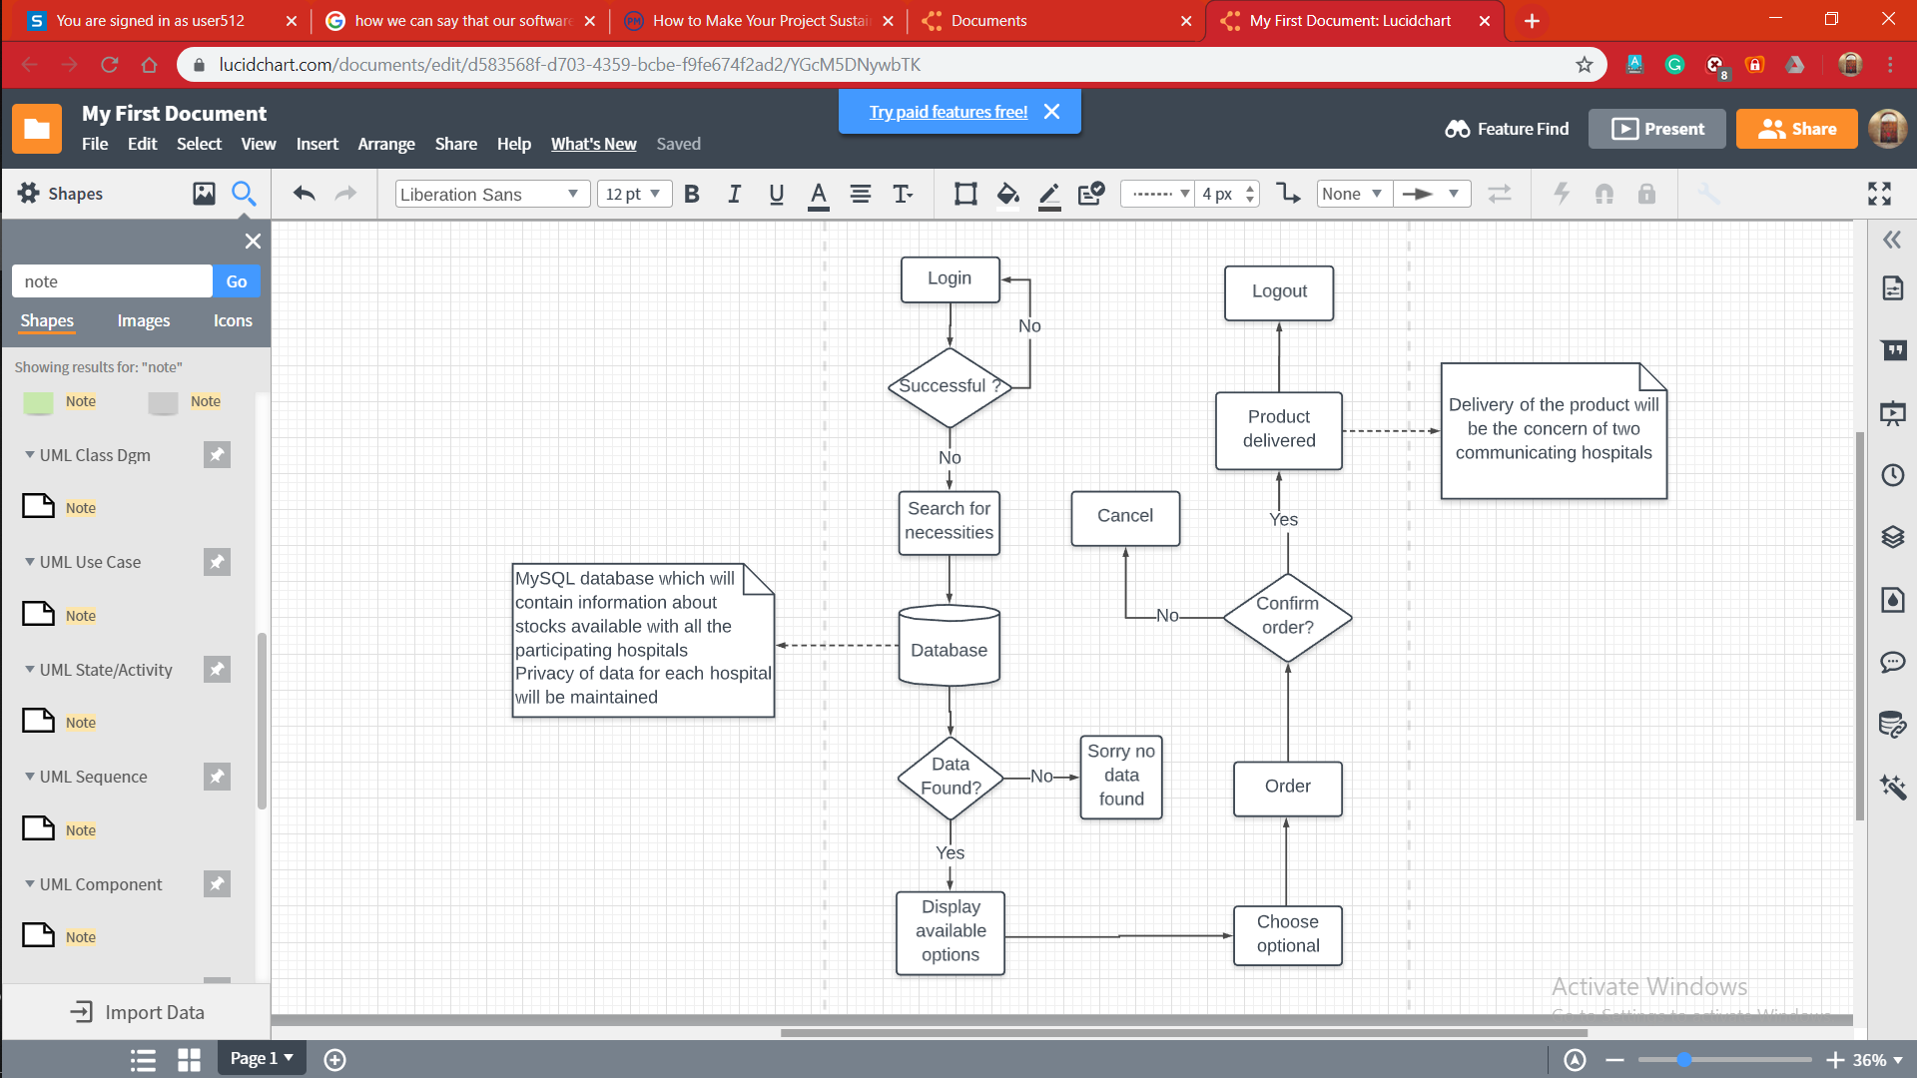
Flow Diagram

Slide 33
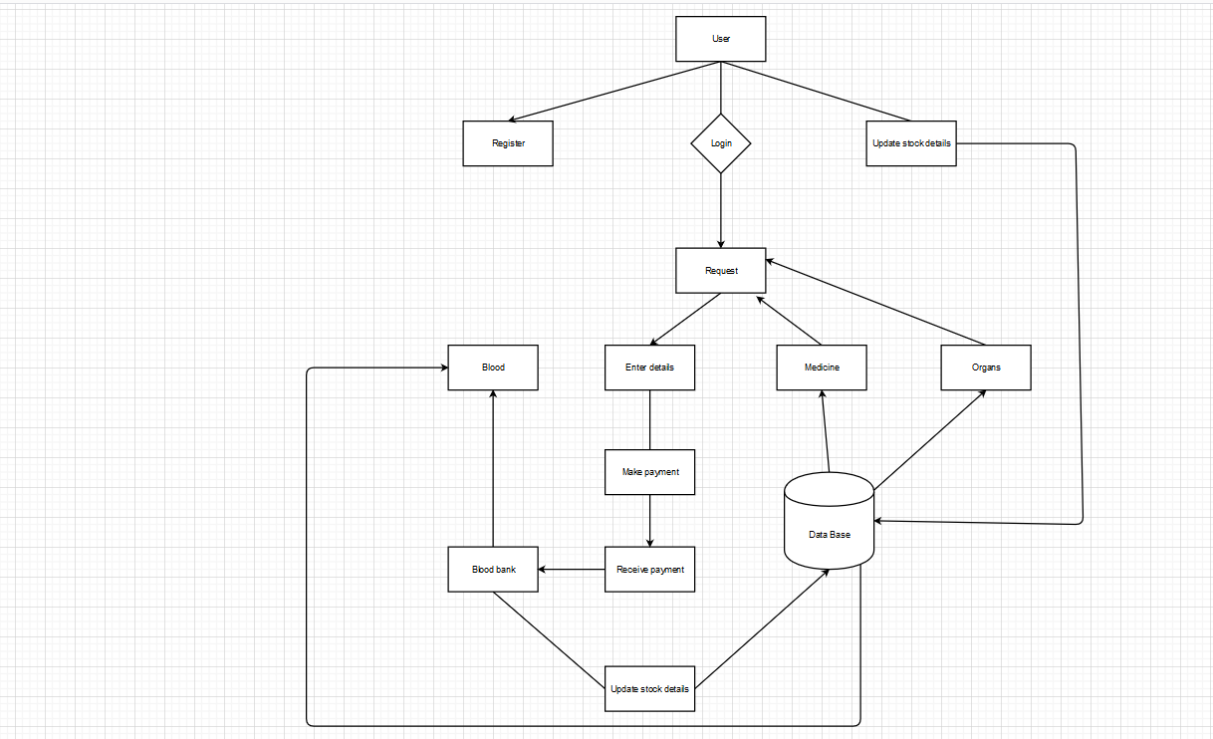

Slide 34
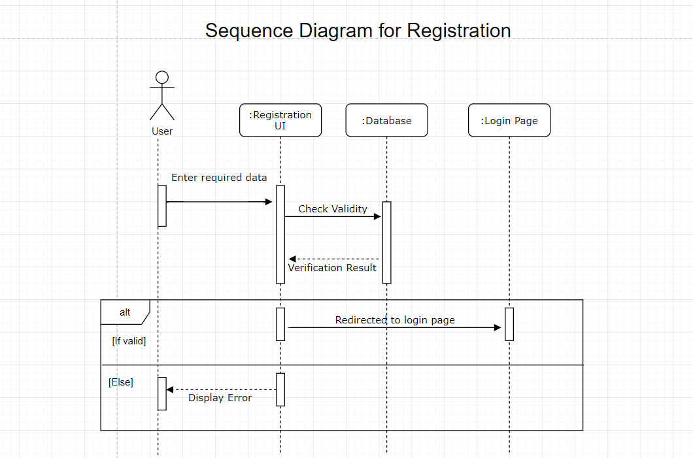

Slide 35
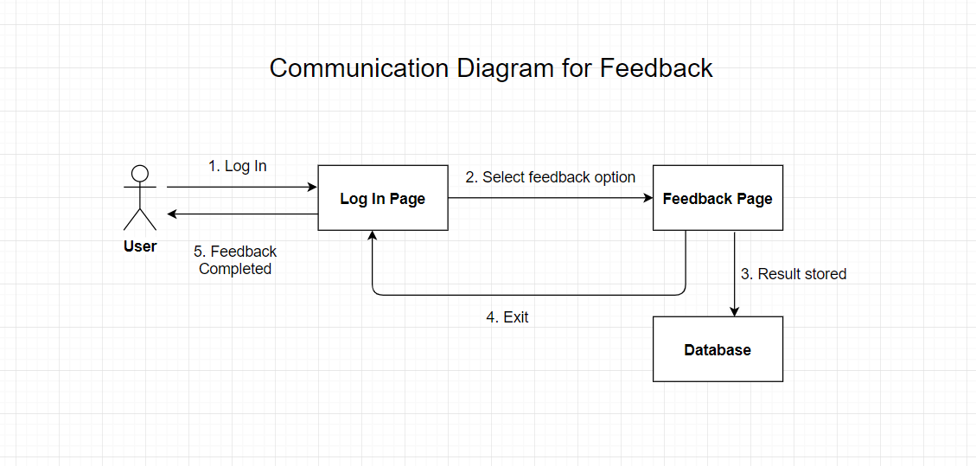

Slide 36
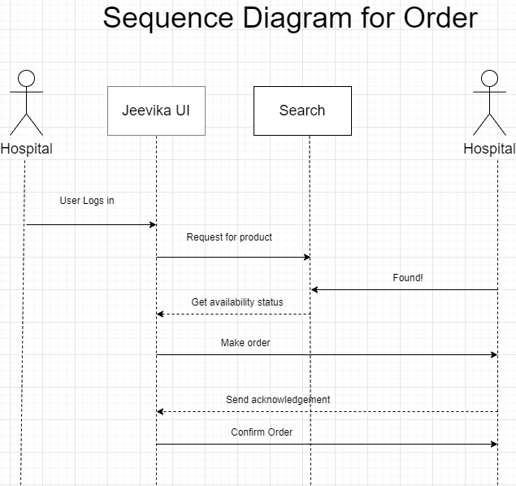

Slide 37
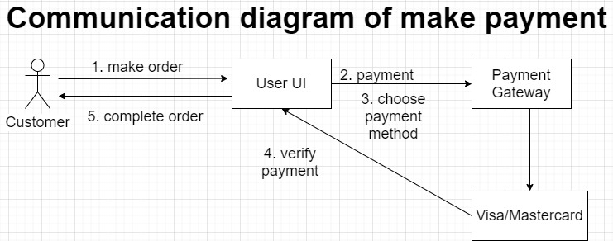

Slide 38
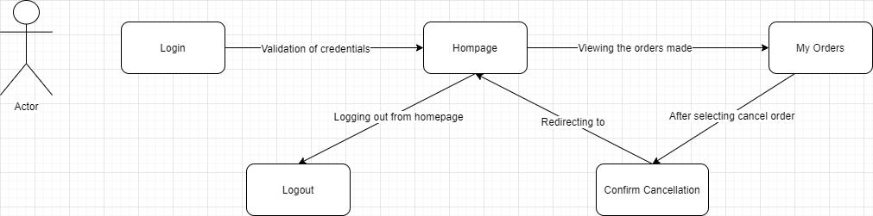
COMMUNICATION DIAGRAM FOR CANCEL

Slide 39
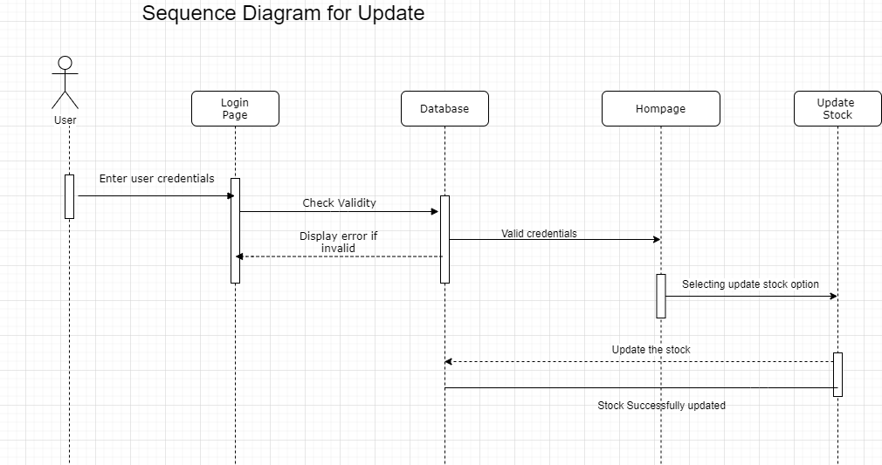

Slide 40
FEASIBILITY REPORT
TECHNICAL
As the available stock details are already there with hospitals there is no need of special dedicated data base for every hospital.
Only a centralised database is enough to operate the application.
Django Framework which is freely available can be used for building our application.
Optimum speed of internet is enough to make a connection.
Such connectivity models are already in existence in some of the companies, so it will not be hard to build such network.

Slide 41
FEASIBILITY REPORT
FINANCIAL
As the records of storage of blood, medicines, organs are already there with hospitals no other special efforts or team is needed to keep the records of them.
Just financial support needed will be for development of application.
We will be using MySQL for data base which is open source database.
Django framework is also available free online.
There is no need of having high manpower as only team of 2-3 people will be needed to maintain the software.
There is no extra cost on buying a new hardware as the system can work on hospitals regular machines.

Slide 42
THANKYOU!

